Slide 1
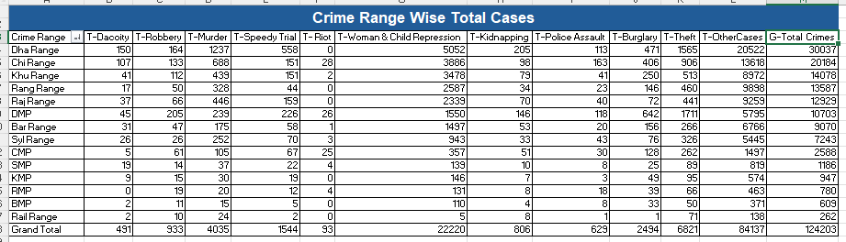
Bangladesh Police Division Range Wise Total Cases Data Analysis (2015)
Crime Range Statistics Overview:
Dha Range: The region with the highest number of crimes across categories, particularly in Murder (1237), Robbery (164), and Woman & Child Repression (5052). No Riot cases reported here.
Chi Range: Moderate crime rate with notable cases in Robbery (133) and Murder (688). Significant Woman & Child Repression (3886) and Theft (906).
Khu Range: Lower crime numbers overall but still significant in Robbery (151) and Murder (439).
Rang Range: Shows fewer total crimes with 44 reported in Murder and 2339 in Other Cases.
Rail Range: Reports the lowest crime incidents with only 2 Robbery cases and 2 Murder cases, highlighting the safest region.
Grand Total: Total of 124,203 crimes across all regions, with Dha Range being the most affected by various crimes.
Key Insights:
Dha Range stands out as the region with the highest crime rates across multiple categories.
Rail Range has the lowest crime statistics, indicating a relatively safe environment.

Slide 2
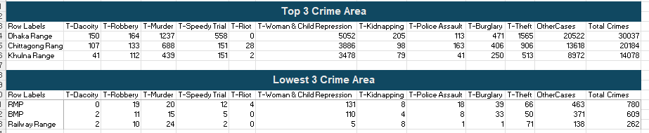
Crime Statistics Overview: Top 3 and Lowest 3 Areas
Top 3 Crime Areas:
Dhaka Range: Highest crimes in Murder (1237) and Robbery (164), total 30,037 crimes.
Chittagong Range: Significant Robbery (133) and Murder (688), total 20,184 crimes.
Khulna Range: Moderate crimes, especially in Murder (439) and Theft (513), total 14,078 crimes.
Lowest 3 Crime Areas:
RMP: Low crime rates, with 780 total crimes.
BMP: Minimal crimes, with 609 total cases.
Railway Range: Safest region, reporting only 262 total crimes.
Key Insights:
Dhaka Range has the highest crime rates.
Railway Range is the safest area with the lowest crime levels

Slide 3
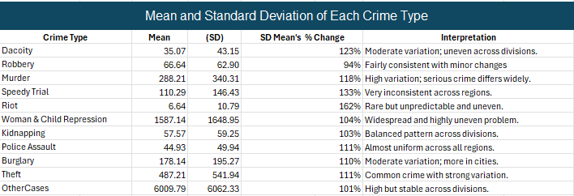
Mean and Standard Deviation Overview
Crime Types: Overview of Mean and Standard Deviation
Dacoity: Moderate variation (123% change).
Robbery: Consistent with minor regional differences (94% change).
Murder: High variation, serious crime differs widely (118% change).
Speedy Trial: Very inconsistent (133% change).
Riot: Rare and unpredictable (162% change).
Woman & Child Repression: Widespread and uneven (104% change).
Kidnapping: Balanced across regions (103% change).
Police Assault: Almost uniform (111% change).
Burglary: Moderate variation, more in cities (110% change).
Theft: Common with strong regional variation (111% change).
Other Cases: High but stable (101% change).
Key Insights:
Murder and Speedy Trials show the most variation across regions.
Riot and Woman & Child Repression are rare but highly uneven.
Theft is common but varies significantly by region.

Slide 4
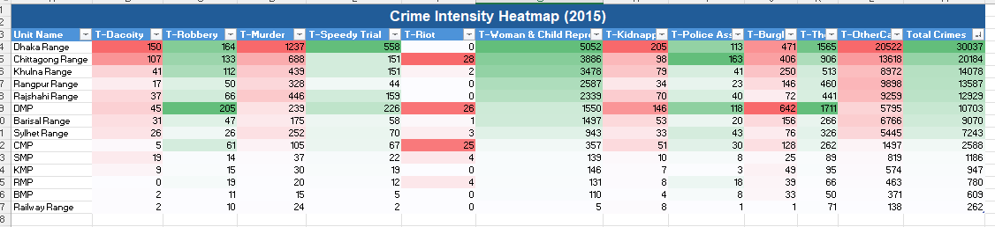
Crime Intensity Overview (2015)
Crime Intensity Overview (2015)
Dhaka Range: The highest crime levels in Murder (1237), Dacoity (150), and Woman & Child Repression (5052).
Chittagong Range: Significant crimes in Murder (688), Robbery (133), and Woman & Child Repression (3886).
Khulna Range: Moderate crime rates with notable cases in Murder (439) and Robbery (112).
Rangpur Range: Lower crime intensity, but high in Murder (328) and Other Cases (8972).
Raj-shahi Range: Crimes concentrated in Murder (446) and Other Cases (2599).
DMP: Lower crime intensity with notable cases in Robbery (205) and Woman & Child Repression (1597).
Other Areas (SMP, CMP, KMP, etc.): Generally lower crime rates, with the Railway Range showing the least number of crimes.
Key Insights:
Dhaka Range is the most affected by various crimes, especially Murder and Woman & Child Repression.
Khulna and Rangpur show moderate crime levels, with a focus on Murder and Theft.
Railway Range reports the lowest overall crime intensity across all categories.

Slide 5
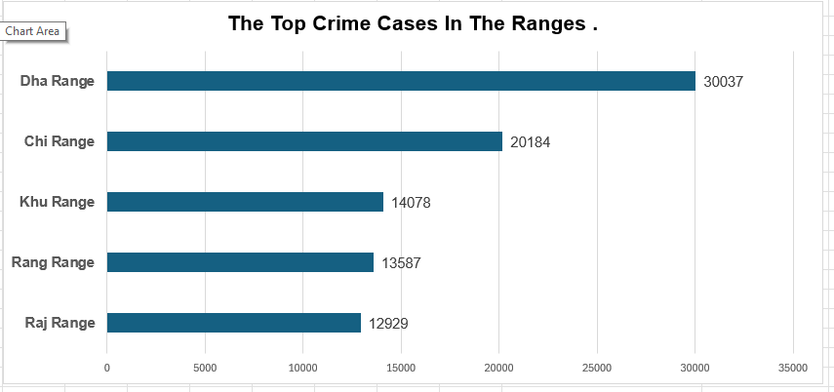
Top Crime Cases in Different Ranges
Top Crime Cases in Different Ranges
Dhaka Range: The highest number of crime cases, totaling 30,037.
Chittagong Range: Second highest with 20,184 reported crimes.
Khulna Range: Reports 14,078 crime cases.
Rangpur Range: With 13,587 reported crimes.
Raj-shahi Range: Total of 12,929 crimes.
Key Insights:
Dhaka Range stands out with a significantly higher crime count compared to other regions.
Chittagong follows as the second most affected, with a noticeable drop in crime numbers in the other regions.

Slide 6
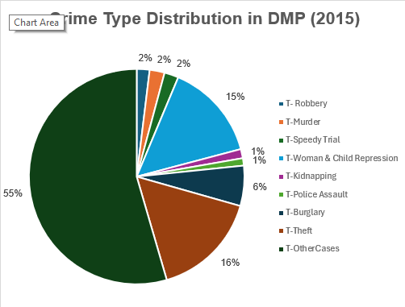
Crime Type Distribution in DMP (2015)
Crime Type Distribution in DMP (2015)
Theft: The most significant crime, accounting for 55% of all cases.
Robbery: Contributes 16% of the total crime cases.
Woman & Child Repression: Represents 15% of the total.
Murder: Accounts for 6% of crimes.
Police Assault: Contributes 2% of the total.
Burglary: Also makes up 2% of the cases.
Speedy Trial: Represents 2% of total crimes.
Kidnapping: Accounts for 1% of the total.
Key Insights:
Theft is by far the most prevalent crime in DMP, making up over half of all reported cases.
Robbery and Woman & Child Repression are the next most significant crimes.
Murder, Police Assault, Burglary, and Speedy Trial contribute a smaller portion of the total crime distribution.

Slide 7
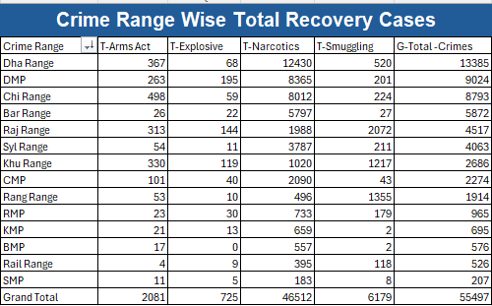
Bangladesh Police Division Range Wise Total Recovery Cases Data Analysis (2015)
Crime Recovery Cases by Range
Dha Range: 13,385 cases, mainly in Narcotics (12,430).
DMP: 9,024 cases, led by Narcotics (8,365).
Chi Range: 8,793 cases, primarily Narcotics (8,012).
Bar Range: 5,587 cases, mostly in Narcotics (5,797).
Raj Range: 4,517 cases, mainly Smuggling (2,072) and Narcotics (1,988).
Syl Range: 4,063 cases, focused on Narcotics (3,787).
Khu Range: 2,668 cases, with Smuggling (1,217) and Narcotics (1,020).
CMP: 2,274 cases, led by Narcotics (2,090).
Rang Range: 1,914 cases, mostly in Narcotics (1,496).
RMP: 965 cases, mainly Narcotics (733).
KMP: 691 cases, mostly Narcotics (659).
BMP: 576 cases, mainly Arms Act (17).
Rail Range: 526 cases, focused on Narcotics (395).
SMP: 207 cases, led by Narcotics (183).
Key Insights:
Dha Range has the highest total recovery cases, primarily in Narcotics.
Smuggling is significant in Raj Range and Khu Range.
Narcotics dominates most regions in terms of recovery cases.

Slide 8
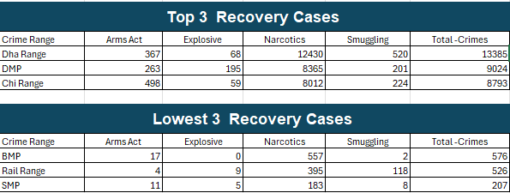
Top and Lowest Recovery Cases by Range
Top 3 Recovery Cases:
Dha Range: The highest recovery cases with 13,385 total, mainly in Narcotics (12,430).
DMP: 9,024 total recovery cases, driven by Narcotics (8,365).
Chi Range: 8,793 total recovery cases, primarily in Narcotics (8,012).
Lowest 3 Recovery Cases:
BMP: 576 total recovery cases, with Narcotics (557) as the main category.
Rail Range: 526 total recovery cases, dominated by Narcotics (395).
SMP: 207 total recovery cases, mainly in Narcotics (183).
Key Insights:
Dha Range leads significantly in total recovery cases, especially in Narcotics.
BMP, Rail Range, and SMP show the lowest recovery numbers, with Narcotics being the primary recovered crime type.

Slide 9
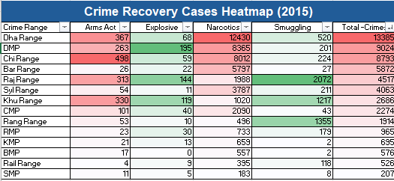
Crime Recovery Cases Heatmap (2015)
Top Recovery Cases:
Dha Range: The highest total recovery cases with 13,385, primarily driven by Narcotics (12,430) and Arms Act (367).
DMP: 9,024 total recovery cases, with Narcotics (8,365) being the main contributor.
Chi Range: 8,793 total cases, dominated by Narcotics (8,012).
Lowest Recovery Cases:
BMP: 576 total recovery cases, mainly Narcotics (557).
Rail Range: 526 total cases, primarily from Narcotics (395) and Smuggling (118).
SMP: 207 total cases, mainly Narcotics (183).
Key Insights:
Dha Range has the highest recovery cases, driven by Narcotics.
Narcotics is the dominant recovery case across most regions.
BMP, Rail Range, and SMP report the lowest recovery cases, primarily in Narcotics

Slide 10
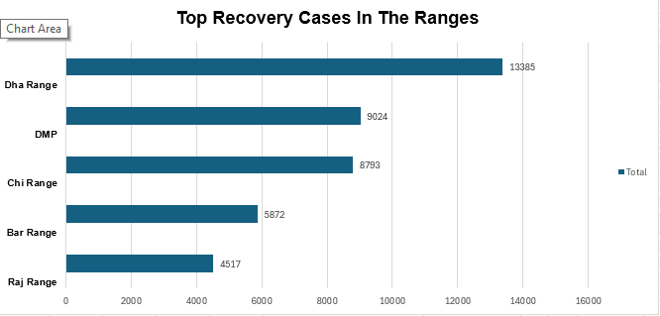
Top Recovery Cases in the Ranges
Top Recovery Cases in the Ranges
Dha Range: The highest recovery cases, with 13,385 total cases.
DMP: 9,024 total recovery cases, the second highest.
Chi Range: 8,793 total recovery cases, following closely.
Bar Range: 5,872 total recovery cases.
Raj Range: 4,517 total recovery cases.
Key Insights:
Dha Range stands out significantly with the highest recovery cases.
DMP and Chi Range also report substantial recovery cases, with Dha Range leading by a large margin.

